Slide 1
Introduction to Python
Peter Crowther

Slide 2
Outline
Motivation
Libraries
IDEs
Where to go for help
Outline of this course

Slide 3
Why Python vs Excel/Sigmaplot/ Origin etc?
Much more powerful
Maths and statistics are easy
High dimensional data
Work with many data formats directly
Beautiful plots
Automation
Run the same analysis on 1000 files as easily as 1
Free!

Slide 4
Why Python vs other languages?
Intuitive to learn
Interactive – no compilation, no dynamic typing
“Human readable” code

Slide 5
Why Python vs other languages?
Intuitive to learn
Interactive – no compilation, no dynamic typing
“Human readable” code
Define a grid of numbers and print to screen:

Slide 6
Why Python vs other languages?
C:
int main() {
int my_array[3][3] = 10, 23, 42, 1, 654, 0, 40652, 22, 0
int index;
int jdex;
for( index = 0; index < (sizeof( my_array ) / sizeof( my_array[0] )); index++){
for( jdex = 0; jdex < (sizeof( my_array ) / sizeof( my_array[0] )); jdex++){
printf( "%d", my_array[index][jdex] );
printf( "\n" );
}
}
}

Slide 7
Why Python vs other languages?
Python:
def main():
my_list = [[10, 23, 42], [1, 654, 0], [40652, 22, 0]]
print my_list

Slide 8
Why Python vs other languages?
Intuitive to learn
Interactive – no compilation, no dynamic typing
“Human readable” code
Good ‘glue’ language
Useful to scientists who are not developers
Many bindings to other languages

Slide 9
Why Python vs other languages?
Intuitive to learn
Interactive – no compilation, no dynamic typing
“Human readable” code
Good ‘glue’ language
Useful to scientists who are not developers
Many bindings to other languages
Good entry to the market
The “big 3” are waning – more open market. Skills are important not a specific language

Slide 10
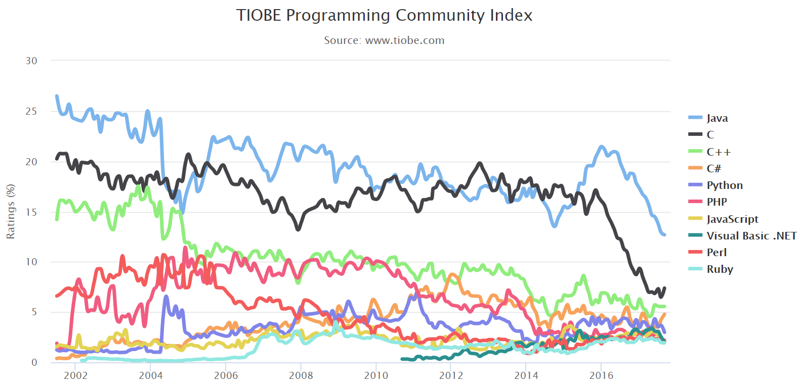
Why Python vs other languages?

Slide 11
Libraries
Python has a core language specification, this has simple functions like arrays (grids of data), flow control, printing to screen etc.
Many more functions can be accessed through libraries
Numpy – Maths and data processing function
FFT, logic, matricies, sorting and searching…
Scipy – Scientific data processing functions
Integration, optimisation, signal processing, graph theory…
Matplotlib – beautiful and powerful graphs

Slide 12
Integrated Development Environments (IDEs)
Python can be written in the simplest text editor
E.g. Notepad (Though I recommend Notepad++ for Windows and Atom for Unix)
Run from command prompt

Slide 13
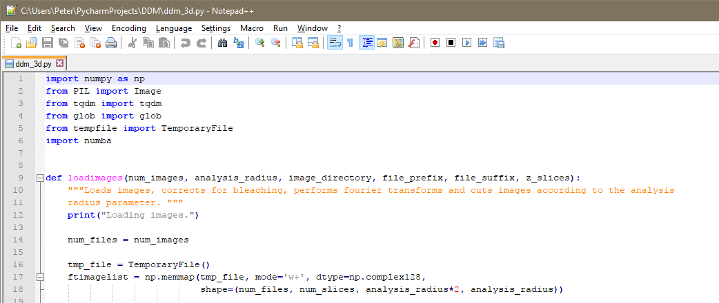
Integrated Development Environments (IDEs)
Python can be written in the simplest text editor
E.g. Notepad (Though I recommend Notepad++ for Windows and Atom for Unix)

Slide 14
Integrated Development Environments (IDEs)
Python can be written in the simplest text editor
E.g. Notepad (Though I recommend Notepad++ for Windows and Atom for Unix)
Intermediate IDE’s provide some extra functions
Inline code execution, saves variables in background
Jupyter (formerly Ipython) notebooks, (IDLE)

Slide 15
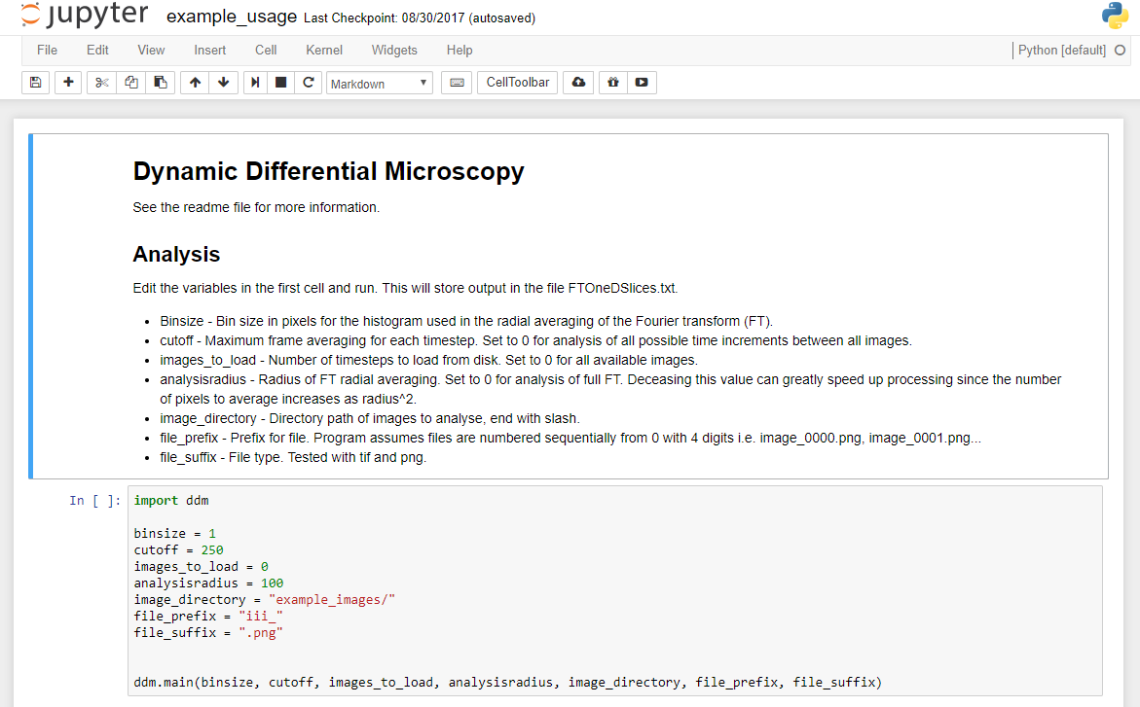
Integrated Development Environments (IDEs)
Python can be written in the simplest text editor
E.g. Notepad (Though I recommend Notepad++ for Windows and Atom for Unix)
Intermediate IDE’s provide some extra functions
Inline code running, saves variables in background
Jupyter (formerly Ipython) notebooks

Slide 16
Integrated Development Environments (IDEs)
Python can be written in the simplest text editor
E.g. Notepad (Though I recommend Notepad++ for Windows and Atom for Unix)
Intermediate IDE’s provide some extra functions
Inline code execution, saves variables in background
Jupyter (formerly Ipython) notebooks, (IDLE)
Fully fledged IDE’s
Built in debuggers, performance monitoring, integration with many programming tools – complex!
Recommend PyCharm

Slide 17
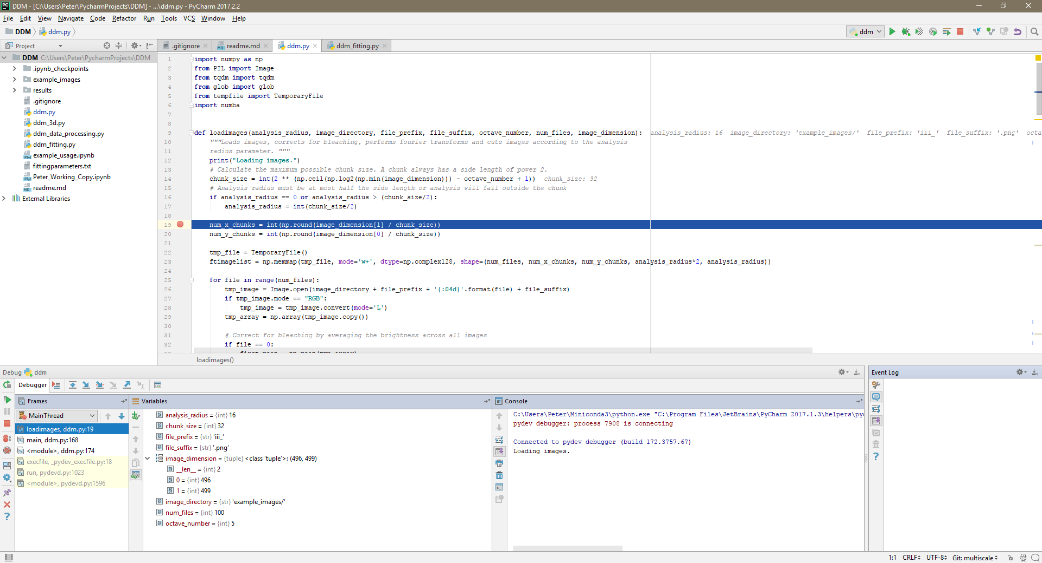
Integrated Development Environments (IDEs)
Python can be written in the simplest text editor
E.g. Notepad (Though I recommend Notepad++ for Windows and Atom for Unix)
Intermediate IDE’s provide some extra functions
Inline code running, saves variables in background
Jupyter (formerly Ipython) notebooks
Fully fledged IDE’s
Built in debuggers, performance monitoring, integration with many programming tools – complex!
Recommend PyCharm

Slide 18
Where to go for help
Python documentation
https://docs.python.org/3/
Numpy/Scipy documentation
https://docs.scipy.org/doc/numpy/
https://docs.scipy.org/doc/scipy/reference/
Google is your friend!
Phrase questions carefully
Stack Overflow
Many online tutorials, some better than others
Free Ebooks if you are that way inclined
E.g. https://automatetheboringstuff.com/

Slide 19
Course Outline
4 interactive workshops – little formal tuition, learn by doing
Help each other, some will have experience, some none at all
Everyone should complete the basic material
There are extension problems for those interested
Later Course by Dr Paddy Royall covering more details of simulation techniques

